Slide 1
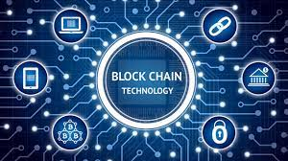
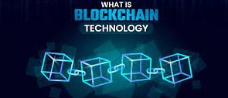
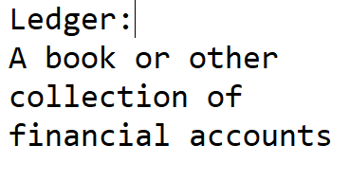
Block Chain
“Block Chain is a type of database”.
A block Chain is a digital Ledger of transactions maintained by a network of computers in a way that makes it difficult to hack or alter.
This content is copied from SRC’s blog/data, so don’t try to copy this. ~SRC

Slide 2
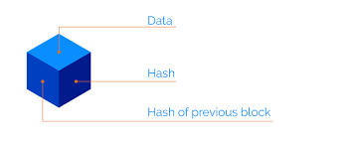
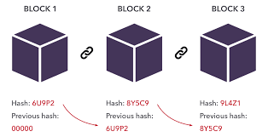
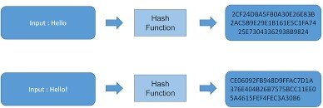
There are three components of block chain
Block data hash
Block data
Previous block hash
Block data hash is the identity of the block. When we store the data in the block of the block chain it will generate a unique code which is called a block data hash.
This hash generates at every transactions and it is the combination of characters and strings. If there is any change in transaction or in a block chain so a new hash is formed and the setting will change and with the help of it, the change in the record can be traced.
Hash of the previous block which links to the next block in the chain.
( The hash of the old block will save into next block the next one hash will be save in another next block ).
All the information of Block Chain is storing in a block as a container.
Example: In case of cryptocurrency like bitcoin stores information about sender, receiver, address, coins etc.

Slide 3

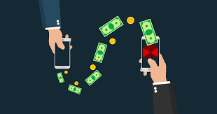
Block-chain Transaction method
Block-chain follows P2P ( peer to peer ) transaction method.
In P2P transaction the participants can directly do payment and chat with each other without any central authority and without any third person. Every Participants have the copy of the ledger and when the transaction takes place the participants note down it. Every participant can access all the information of the block and the advantage is that no one can deceive anyone in block-chain.

Slide 4
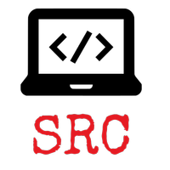
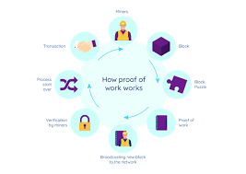
Proof of Work
If a person write some data in the block, he/she cannot alter or change it at will but if he/she want to change the data of the block so first you have to share your change with all the participants in the network if the majority participants don't like your change so it will be rejected.
This is called 'Proof of work' in which we have to proof the participants about your change.
This content is copied from SRC’s blog/data, so don’t try to copy this. ~SRC

Slide 5

Uses of Blockchain
NFT market place
Cryptocurrency exchange
Voting mechanism
Secure sharing of medical data
Their are a lot of more places where we can take the advantage of this technology.
This content is copied from SRC’s blog/data, so don’t try to copy this. ~SRC

